Slide 1

Discussion 7
EE599: Deep Learning
Olaoluwa Adigun
Spring 2020
Contributors: Olaoluwa Adigun

Slide 2




Training MLP with Backpropagation
Find the best parameter $Θ^{∗}$ that minimizes the cost function
Input layer $x$
Hidden layer $h_{1}$
Hidden layer $h_{2}$
Output layer $t$
Backpropagation uses a variant of stochastic gradient descent to updates the weights

Slide 3



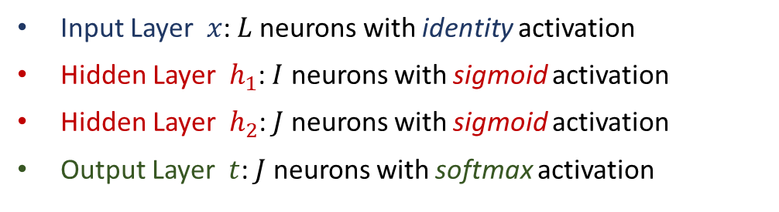




Model Architecture
$$V$$
$$U$$
$$W$$
Input layer $x$
Hidden layer $h_{1}$
Hidden layer $h_{2}$
Output layer $t$
Input Layer $x$: $L$neurons with identity activation
Hidden Layer $h_{1}$: $I$ neurons with sigmoid activation
Hidden Layer $h_{2}$: $J$ neurons with sigmoid activation
Output Layer $t$: $J$ neurons with softmax activation

Slide 4
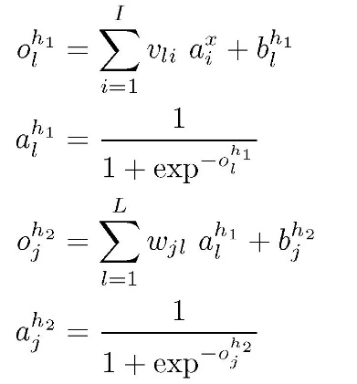
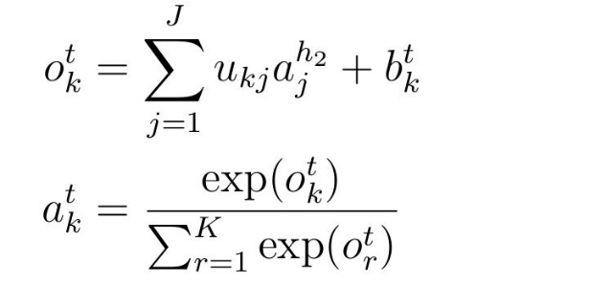





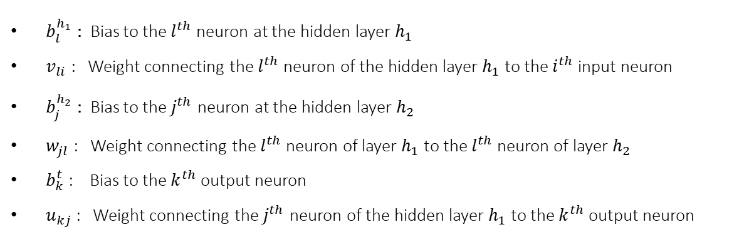


Forward Pass over MLP Model (Inference)
$$V$$
$$U$$
$$W$$
Input layer $x$
Hidden layer $h_{1}$
Hidden layer $h_{2}$
Output layer $t$
$b_{l}^{h_{1}}$ : Bias to the $l^{th}$ neuron at the hidden layer $h_{1}$
$v_{li}$ : Weight connecting the $l^{th}$ neuron of the hidden layer $h_{1}$ to the $i^{th}$ input neuron
$b_{j}^{h_{2}}$ : Bias to the $j^{th}$ neuron at the hidden layer $h_{2}$
$w_{jl}$ : Weight connecting the $l^{th}$ neuron of layer $h_{1}$ to the $l^{th}$ neuron of layer $h_{2}$
$b_{k}^{t}$ : Bias to the $k^{th}$ output neuron
$u_{kj}$ : Weight connecting the $j^{th}$ neuron of the hidden layer $h_{1}$ to the $k^{th}$ output neuron

Slide 5
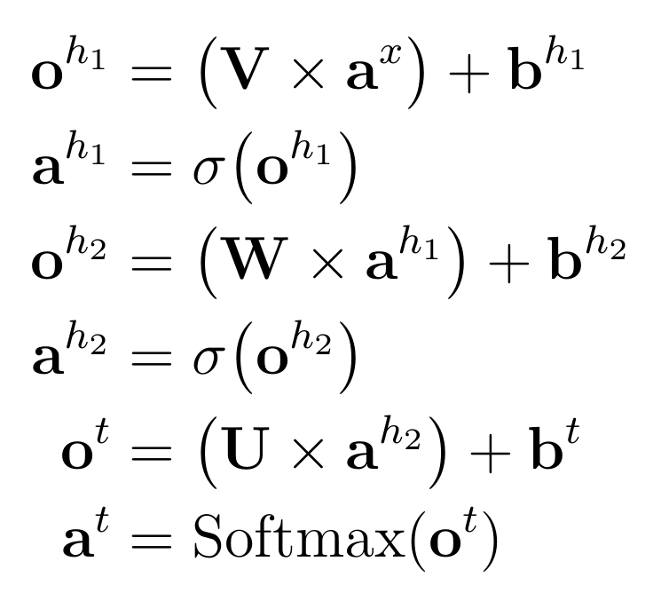







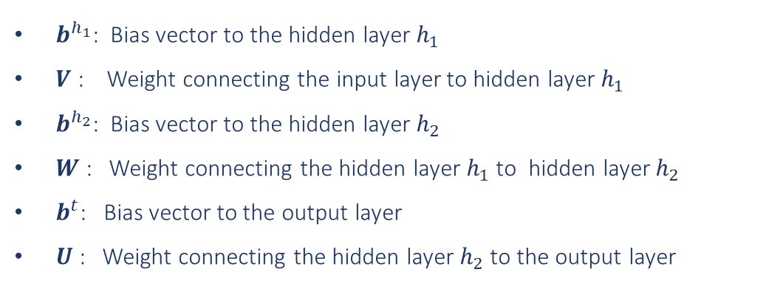
Forward Pass over MLP Model (Inference)
$$V$$
$$W$$
$$U$$
Input layer $x$
Hidden layer $h_{1}$
Hidden layer $h_{2}$
Output layer $t$
$b^{h_{1}}$: Bias vector to the hidden layer $h_{1}$
$V$ : Weight connecting the input layer to hidden layer $h_{1}$
$b^{h_{2}}$: Bias vector to the hidden layer $h_{2}$
$W$ : Weight connecting the hidden layer $h_{1}$ to hidden layer $h_{2}$
$b^{t}$: Bias vector to the output layer
$U$ : Weight connecting the hidden layer $h_{2}$ to the output layer

Slide 6
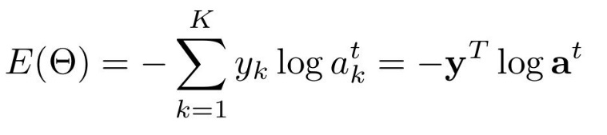
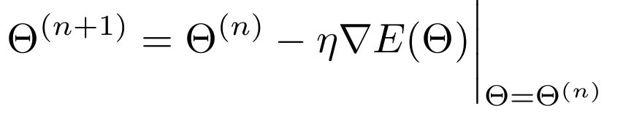
Error Function and Backpropagation
$$V$$
$$W$$
$$U$$
Input layer $x$
Hidden layer $h_{1}$
Hidden layer $h_{2}$
Output layer $t$
Cross entropy
Update rule

Slide 7





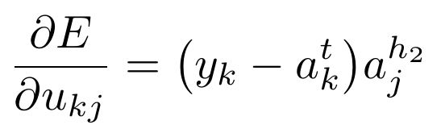
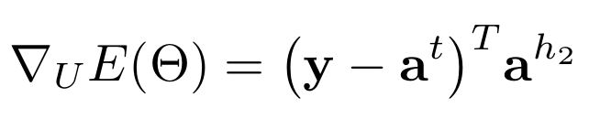


Backpropagation Update Rule
$$V$$
$$W$$
$$U$$
Input layer $x$
Hidden layer $h_{1}$
Hidden layer $h_{2}$
Output layer $t$

Slide 8



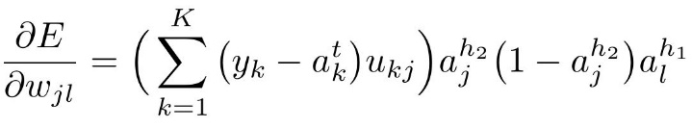
Backpropagation Update Rule
$$V$$
$$W$$
$$U$$
Input layer $x$
Hidden layer $h_{1}$
Hidden layer $h_{2}$
Output layer $t$

Slide 9



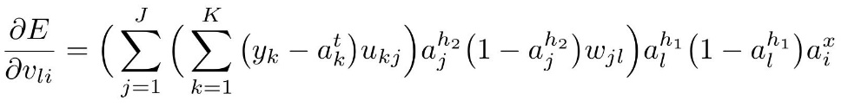
Backpropagation Update Rule
$$V$$
$$W$$
$$U$$
Input layer $x$
Hidden layer $h_{1}$
Hidden layer $h_{2}$
Output layer $t$
Update rule

